Slide 1
Electric Fields

Slide 2
What is an Electric Field?
An electric field is a force field.
An electric field is a vector quantity.
An electric field provides the direction that a positive test charge will move if placed in the field.
An electric field is composed of a series of imaginary lines of force.

Slide 3

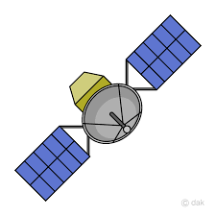


What you already know
Newton’s Universal Law of Gravitation:
$$F_{g}=\frac{GM_{E}m}{r^{2}}$$
Satellite
$$F_{g}$$
Note: Gravity is always attractive.

Slide 4
What you already know
Coulomb’s Law:
Positive Test Charge
+
F
q_{o}
q
Note: q_{o} is much smaller than q!

Slide 5
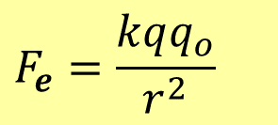
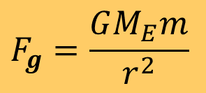


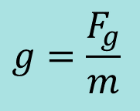
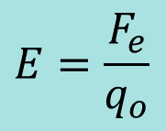


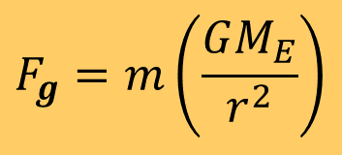
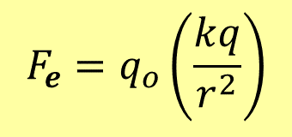
What are Force Fields?
Force fields exert forces on objects under their influence.
Gravitational Force Field:
$$g$$
$$F_{g}=\frac{GM_{E}m}{r^{2}}$$
$$F_{g}=m\left(\frac{GM_{E}}{r^{2}}\right)$$
$$g=\frac{F_{g}}{m}$$
$$F_{g}=m\left(g\right)$$
From the equation, a gravitational force field is a measure of the force per unit of mass, or N/kg.
Electric Force Field:
$$E$$
$$F_{e}=\frac{kqq_{o}}{r^{2}}$$
$$F_{e}=q_{o}\left(\frac{kq}{r^{2}}\right)$$
$$E=\frac{F_{e}}{q_{o}}$$
$$F_{e}=q_{o}\left(E\right)$$
From the equation, an electric force field is a measure of the force per unit of charge, or N/C.

Slide 6
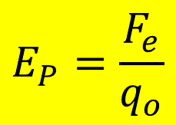
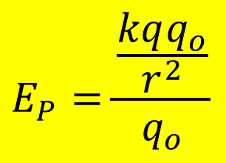
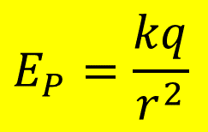
Electric Field
The electric field is the electrostatic force that a positive test charge experiences divided by itself.
$$E_{P}=\frac{\frac{kqq_{o}}{r^{2}}}{q_{o}}$$
$$E_{P}=\frac{F_{e}}{q_{o}}$$
$$E_{P}=\frac{kq}{r^{2}}$$
P
+
E
r
F_{e}
+q_{o}
q
Note: The electric field is a vector quantity and has the same direction as the force that would act on a positively charged test particle.

Slide 7
What is the Test Charge
It is small enough that it does not affect the field due to other charged objects.
It will experience a repulsive or attractive force depending on whether it is charged similarly or dissimilarly from other objects.
+
F
F
+q_{o}
-q_{o}
Q

Slide 8
The Test Charge (Cont.)
F
+q_{o}
+
+
_
_
_
_
+
+
_
+
_
_
+
+
+q_{o}
_
_
+
+
+
F
_
_
+
_
+
_
_
_
+
+
_
+
+
_
_
+
+
_
Test Charge moves away from a positively charged object
Test Charge moves towards a negatively charged object
Positively Charged Object
Negatively Charged Object

Slide 9
Example 1:
A positive charge of 4.0 x 10⁻⁵ C at point P experiences a force of 0.36 N at this location. What is the electric field intensity at point P?
q_{o} = 4.0 x 10⁻⁵C, F_{e} = 0.36 N
E = F_{e}/q_{o}
E = 0.36 N / 4.0 x 10⁻⁵C
E = 9000 N/C
P
+
E
F_{e}
+q_{o}
Q
Note: The electric field intensity says nothing about the magnitude of charge Q, which is the source of the electric field that produces the force that charge q_{o} experiences.

Slide 10
Electric Field Lines
Electric field lines, or lines of force, provide a map of the electric field at any point in space relative to a charge or a group of charges.
Electric field lines show the path that a positive test charge would take if placed in the field.
F
+
+
_
_
_
_
+
+
+q_{o}
_
+
_
_
+
+
_
_
+
+
+
_
_
_
+
_
_
+
+
+
_
_
+
+
_
_
+
+
_

Slide 11
Electric Field Lines
+
-
Electric field lines begin at positive charges and are always directed away from them towards negative charges.
Electric field lines do not start or stop except at the surfaces of positive or negative charges.
Electric field lines are always perpendicular (90°) to the surface where they start or end.
Electric field lines never cross.
The strength of the field is proportional to the magnitude of the charge and is directly related to the density of field lines
  the more lines there are and the closer together they are, the stronger the field.

Slide 12
Electric Field Lines Due to a Point Charge
Density of lines is highest close to the surface of the charged object and decreases radially outward.
Direction of field is away from the positive charge.
+
+
+
+
+
+
+
+
+
+
+
+
+
+
+
+
+
+
Lines intersect the surface of a charged particle at right angles.
Positive Charge

Slide 13

Electric Field Strength and Distance for Point Charges
For point charges:
  The strength of the field decreases as the distance increases.
Weak Field
$$E=\frac{F_{e}}{q_{o}}$$
$$E=\frac{kq}{r^{2}}$$
+
+
+
+
+
+
+
+
+
+
+
+
+
+
+
+
+
+
Strong Field

Slide 14


Example 2:
$$E=k×\frac{Q}{r^{2}}$$
In example No. 1, you found the electric field intensity at some arbitrary point P in space knowing the charge (4.0 x 10⁻⁵ C) of the particle and the force(0.36 N) it experienced. If the value of r is 100 m, what is the magnitude of the charge that was the source the electric field?
From before:
$$E = \frac{F_{e}}{qo}$$
$$E=\frac{0.36N}{{4.0×10}^{−5}C}$$
$$E = 9000N/C$$
E at point P is 9000 N/C
P
+
r
F
q_{o}
Q

Slide 15
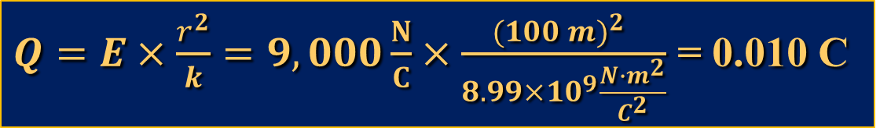
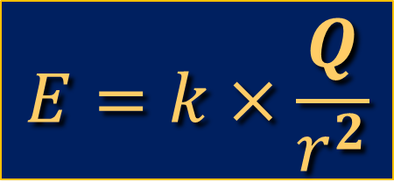
Example 2:
E = 9000 N/C
Everywhere along this arc.
+
r
q_{o}
F_{e}
$$E=k×\frac{Q}{r^{2}}$$
Q
$Q=E×\frac{r^{2}}{k}=9,000\frac{N}{C}×\frac{{(100 m)}^{2} }{8.99×{10}^{9}\frac{N∙m^{2}}{C^{2}}}$ = 0.010 C

Slide 16
Electric Fields and Conductors
E
At equilibrium, excess charges will reside on the surface of a conductor.
The electric field is zero at any point within a conducting material at equilibrium.
Charge within a conductor is shielded from external electric fields because they begin or terminate on the surface where excess charges reside.
+
+
+
+
+
+
+
+
+
+
+
+
+
+
+
+
+
+
No E-Field inside conductor
Faraday’s Cage

Slide 17
Electric Dipole
Note: An electric dipole consists of two charges equal in magnitude and opposite in sign.
+Q
F
-Q
+q_{o}
_
_
_
_
+
+
+
_
+
_
_
+
+
+
_
_
_
+
+
+
_
_
+
_
_
_
+
+
+
_
_
+
+
_
_
+
+
Note: Force on a test charge(q_{o}) is always tangent the field lines, and is the vector sum of the forces due to both charges of the dipole acting on it.

Slide 18
Parallel Plate Capacitor
The parallel plate capacitor is an energy storage device used in all kinds of electronics.
Field lines in a parallel plate capacitor are evenly spaced and parallel to one another, indicating a uniform electric field.
+
+
+
+
+
+
+
+
-
-
-
-
-
-
-
-
E

Slide 19

Electrostatic Force and Distance
For parallel plates:
  The strength of the field is constant from one plate to the other.
  Since E does not vary, the force will be constant.
$${F }_{e}$$

Slide 20
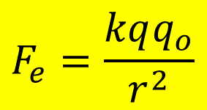
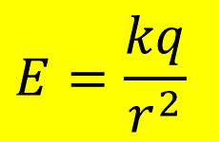

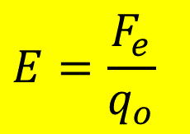
Force and Electric Field Strength vs. Distance
Point Charge Parallel Plate
$$F_{e}=\frac{kqq_{o}}{r^{2}}$$
$$F_{e}=q_{o}E$$
Force
Force
Distance
Distance
$$E=\frac{kq}{r^{2}}$$
$$E=\frac{F_{e}}{q_{o}}$$
E-Field Intensity
E-Field Intensity
Distance
Distance

Slide 21
Example (Millikan Oil Drop Exp.)
An oil drop is negatively charged and weighs 8.5 x 10⁻¹⁴ N. The drop is suspended in an electric field intensity of 5.3 x 10¹ N/C.
What is the charge on the drop?
Since F_{net} = 0N, F_{e} = F_{g}
Eq = mg
q = mg/E = F_{g}/E
q = 8.5 x 10⁻¹⁴ N/53 N/C
q = 1.6 x 10⁻¹⁵C
How many electrons is that?
~10,000 electrons
+ + + + + +
F_{e} = Eq
-
F_{g} = mg
E
- - - - - -

Slide 22
Draw the electric field lines for the following configurations.
+
+
+
+
+
+
+
+
+
-
- - - - - - - - -
-
+
-
-

Slide 23
Examples from the Web
http://www.cco.caltech.edu/~phys1/java/phys1/EField/EField.html
http://phet.colorado.edu/sims/charges-and-fields/charges-and-fields_en.html

Slide 24
Key Ideas
Electric fields exists around any conductor or insulator that contains a charge.
The electric field intensity is a measure of the force on a test charge placed in the field.
The strength of the field is proportional to the density of field lines.
Field lines are perpendicular to all charged surfaces.
The electric field is always directed away from positive charges and towards negative charges.

